Slide 1
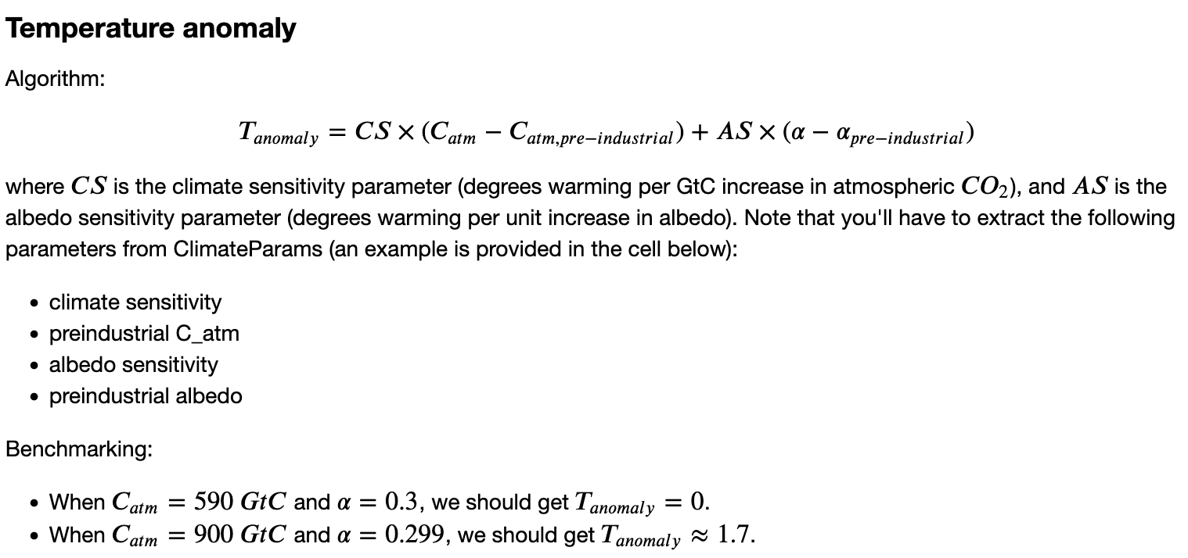
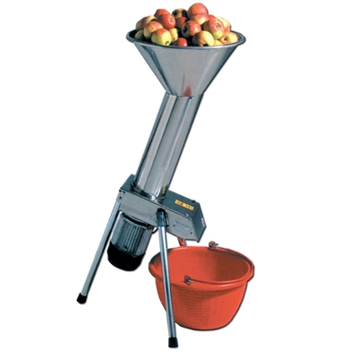
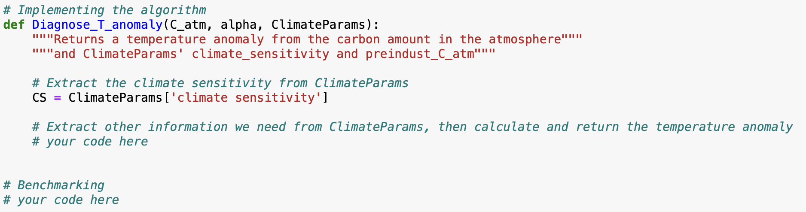
We wrote our own functions in Python (here was an important one)
C_atm, alpha, and ClimateParams go in
T_anomaly comes out

Slide 2
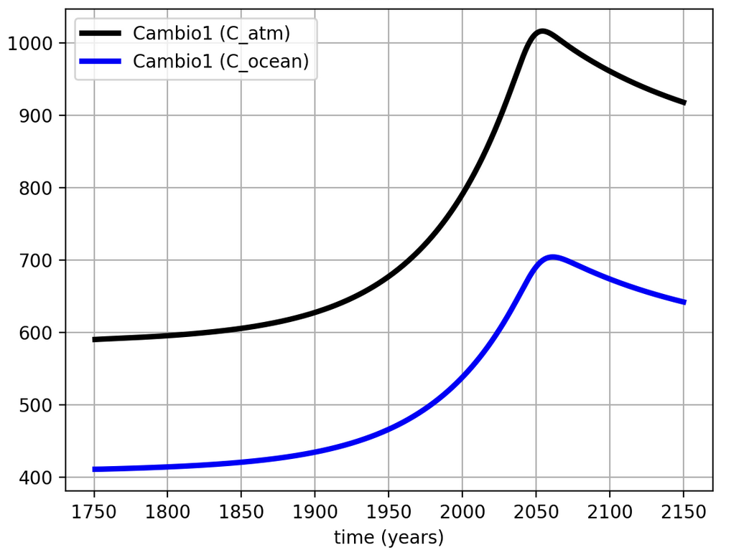
We wrote our own functions in Python (here was another important one)

Slide 3
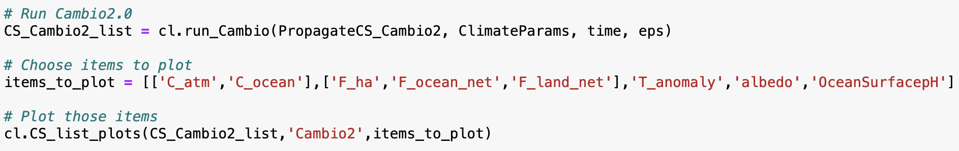
We learned how to take advantage of other functions too

Slide 4
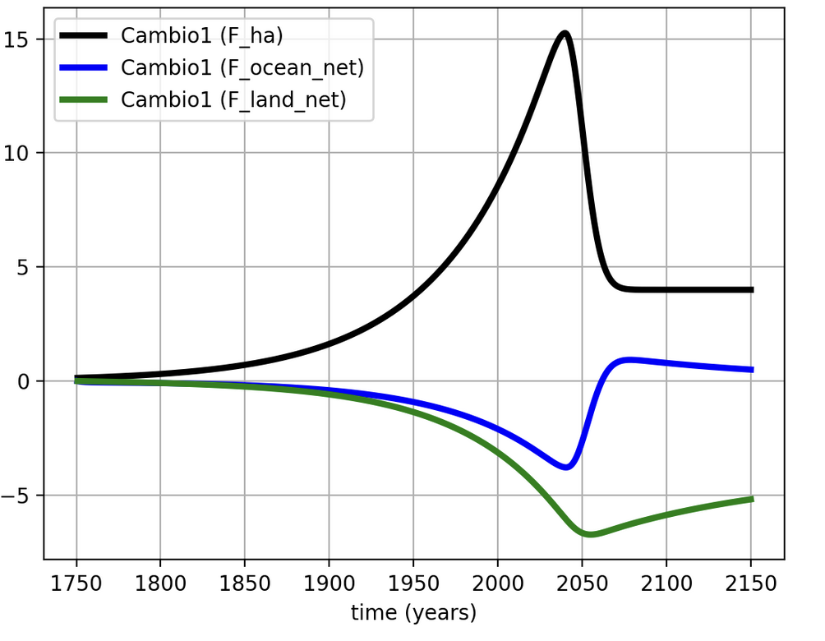
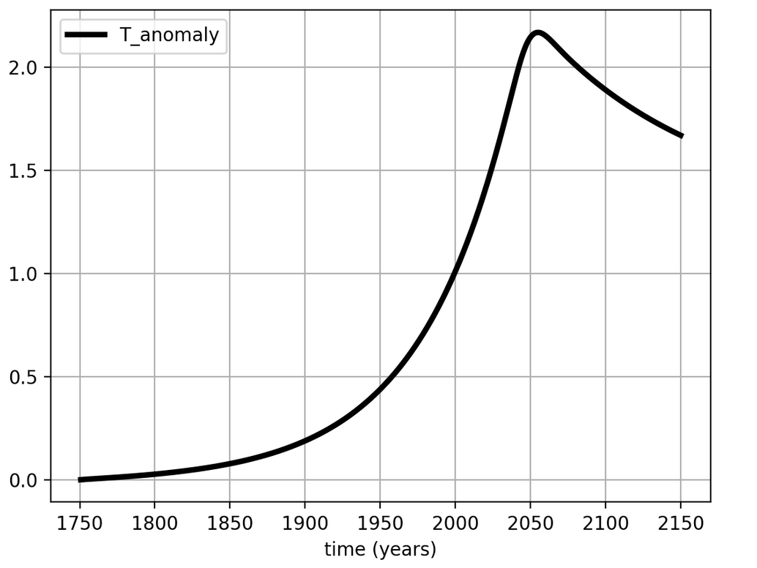
We learned how to take advantage of other functions too

Slide 5

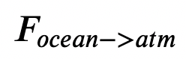
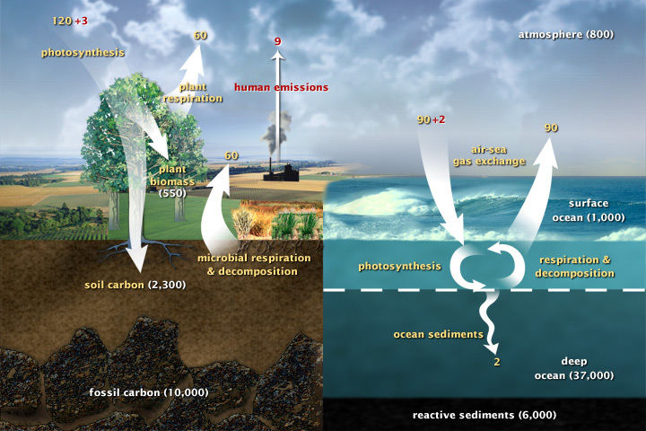
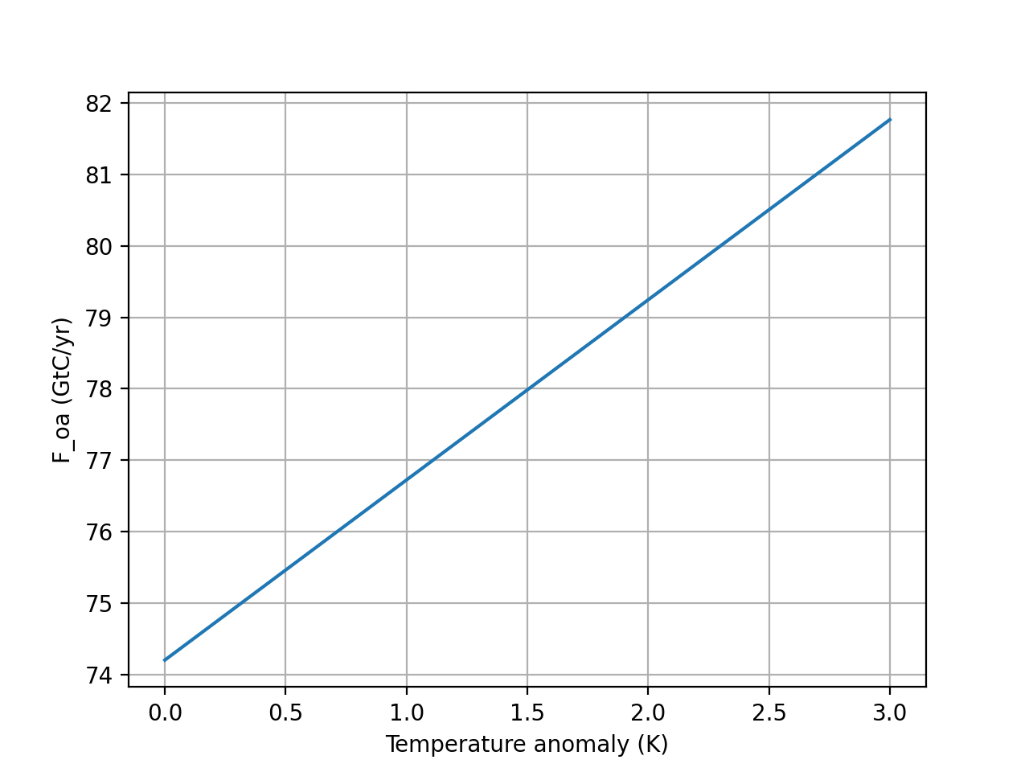


The point of Cambio 2.0 is to use $T_{anomaly}$to take into account the Henry effect
$$F_{ocean→atm}=k_{oa}×(1+T_{anomaly}×DC)[C_{ocean}]$$
This is the Henry effect, whereby gases are less soluble in warmer oceans.
Cold ocean
Warm ocean
$$F_{ocean→atm}$$
$$T_{anomaly}$$

Slide 6

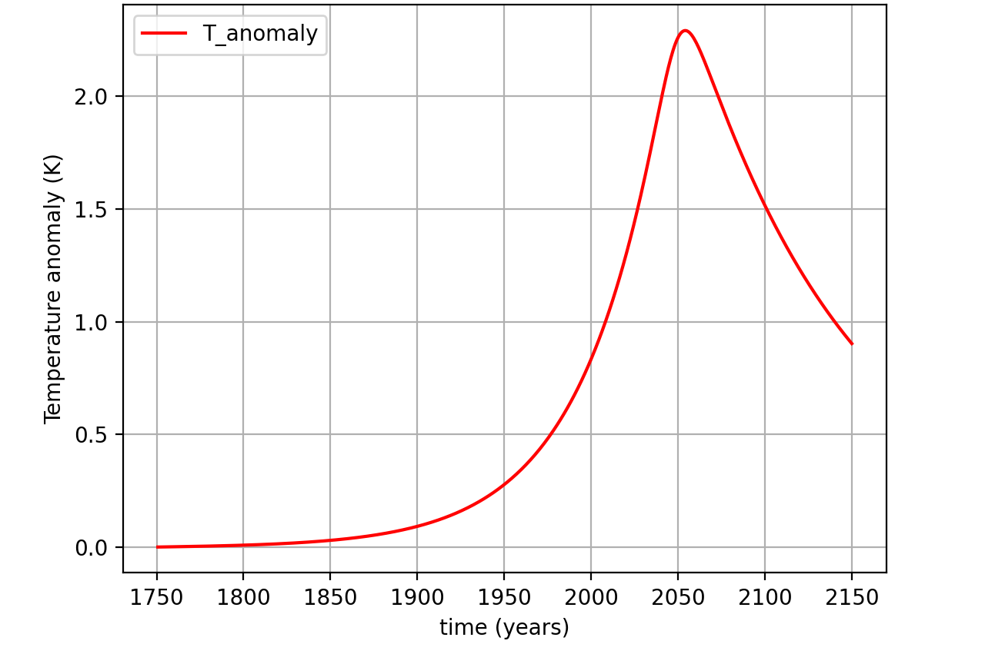
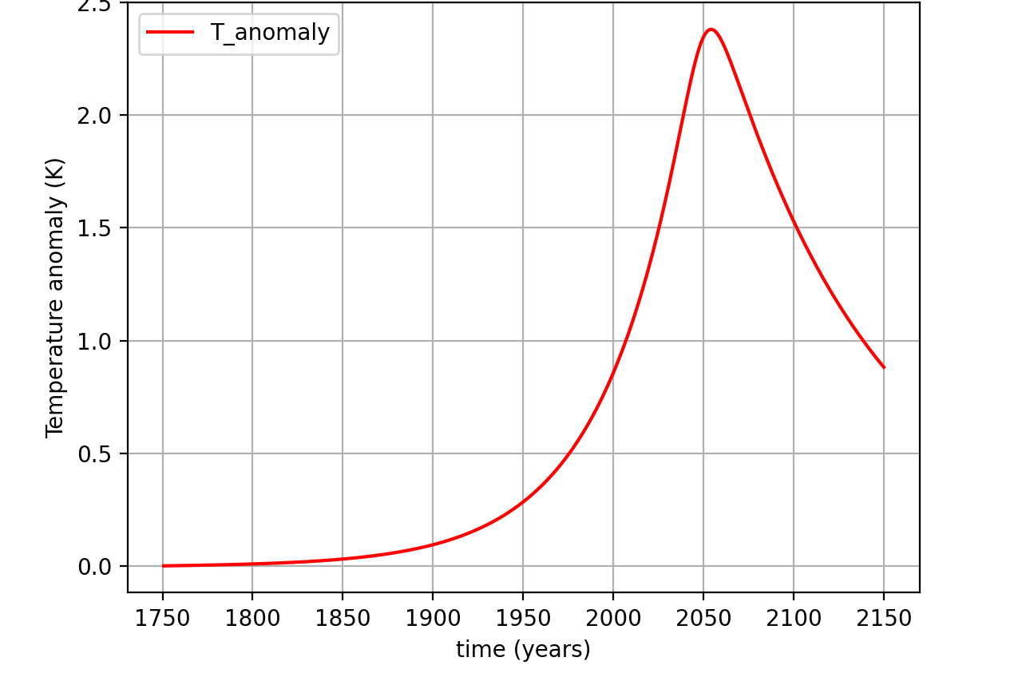
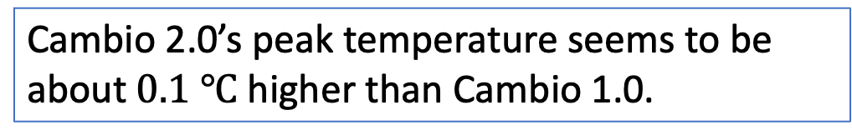
Lessons from Cambio 2.0: as several of you noted, the temperature impact is not great …
Cambio 1.0
Cambio 2.0
Cambio 2.0’s peak temperature seems to be about $0.1 ℃$ higher than Cambio 1.0.
Cold ocean
Warm ocean

Slide 7

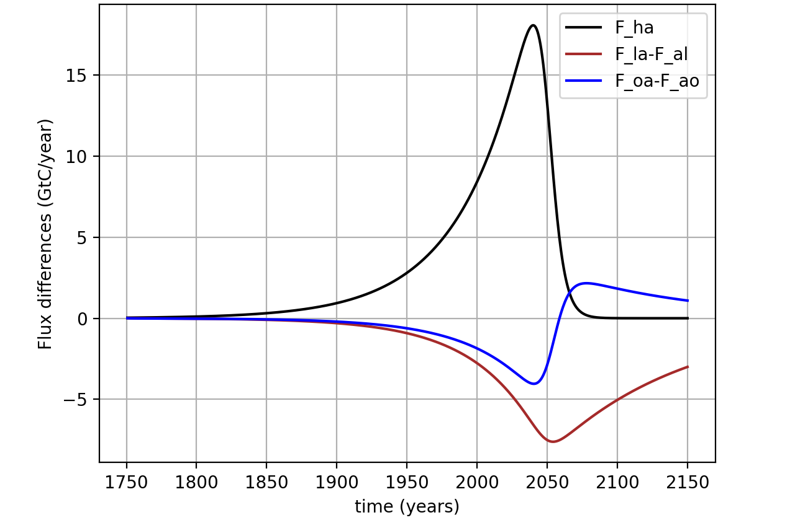

… but it’s also true that our negative feedbacks helped compensate for one another
Cambio 1.0
Cambio 2.0
Discuss in small groups:
We know why Cambio 2.0 has less sequestration by oceans. But why is there more terrestrial sequestration?
Cold ocean
Warm ocean

Slide 8
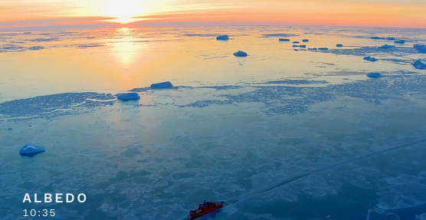
Next week, we’ll be diving into another feedback loop (ice/albedo)
Climate Emergency: Feedback Loops
Director/Co-Writer: Susan Gray
Narrated by Richard Gere
~2021

Slide 9
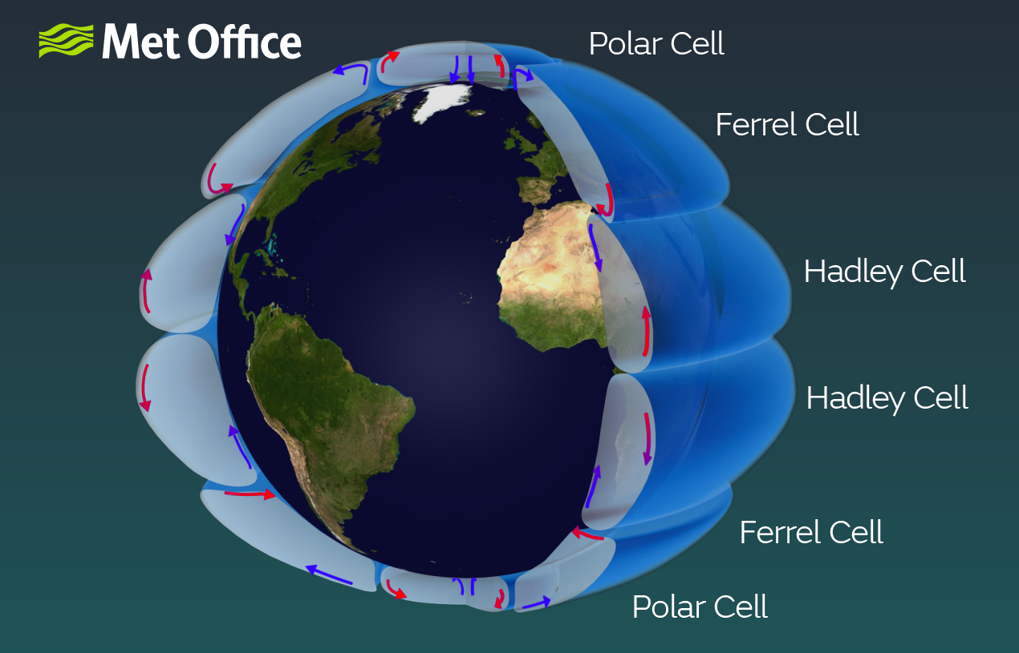
Mentioned in the Albedo video – “wet areas get wetter, dry areas get drier”

Slide 10
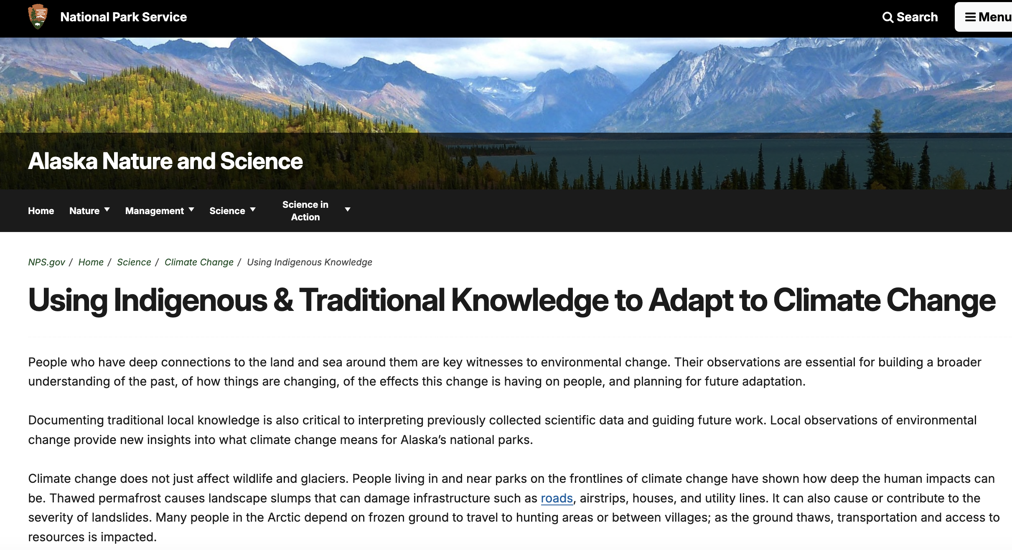
Not mentioned in the Albedo video – indigenous voices

Slide 11
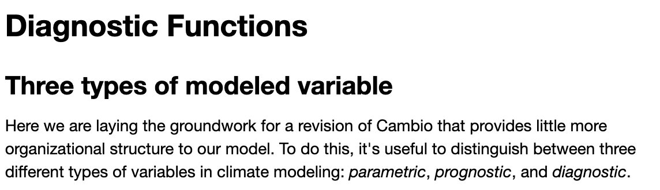
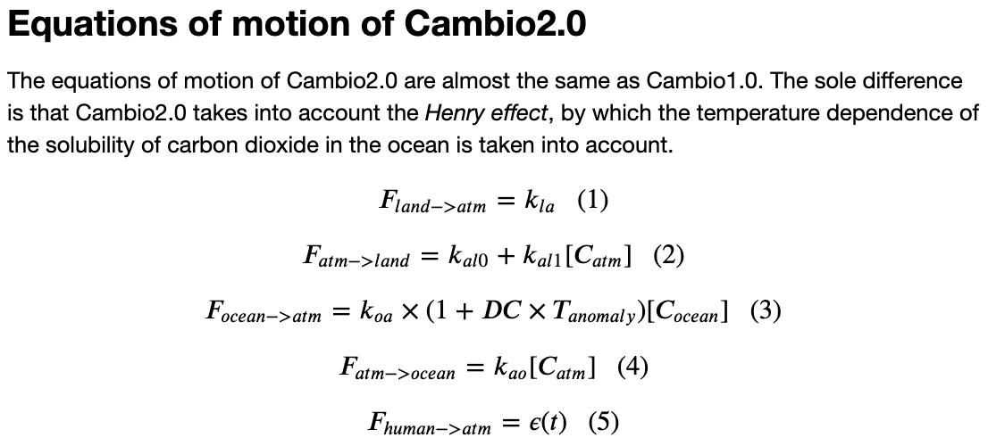
Meanwhile, let’s finish these up
Notes:
Predict the temperature if CO2 continues to rise. If we reduce CO2 emissions to zero.

